Slide 1

Emotion Classification for Banijay
Enhancing Media Analysis with NLP
Banovac, Lea (224055)
Dziechciarz, Michal (225484)
Heesters, Stijn (226180)
Ribeiro Mansilha, Francisco (220387)
van den Berg, Rens (224190)

Slide 2


Project objective
Client goals
Understand what engages the audience
Content classification tool
Analyze shows by the minute

Slide 3

Banijay & Expeditie Robinson
Solution
Build an emotion classification pipeline
Speech-to-Text
Emotion classification
Apply to Expeditie Robinson data

Slide 4
Project Overview
Collecting Data
Processing Data
Emotion Classification Algorithm
Speech-to-Text Algorithm
Pipeline Output

Slide 5
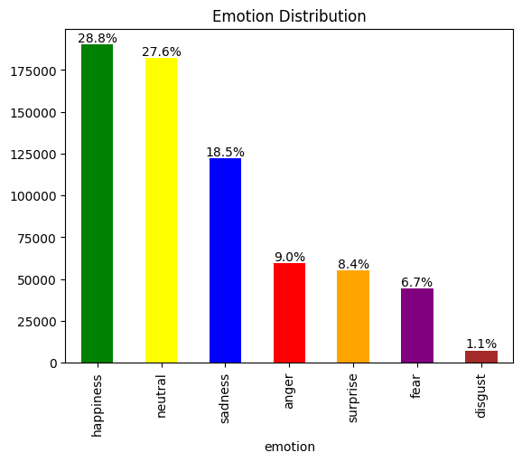
Collecting Data
Internet
GoEmotions
SMILE Twitter Emotion Dataset
Friends emotion-labeled dialogues
MELD
CARER
Affective Text
Daily Dialogue
EmoBank
Affect Data
Google dataset search

Slide 6
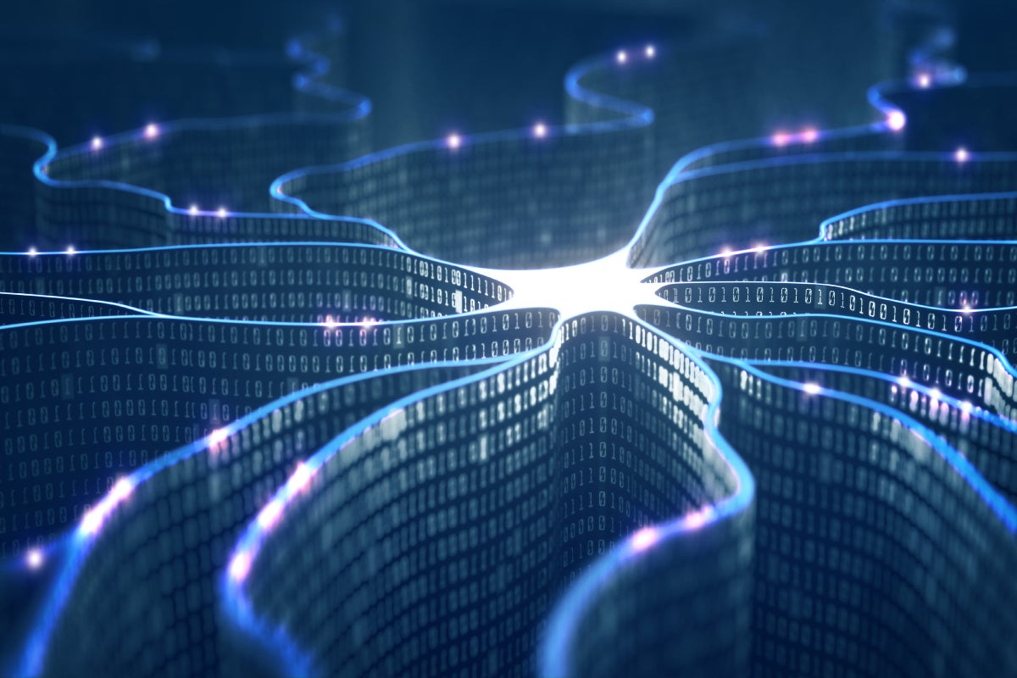
Synthetic Data Generation
Internet
OpenAI API
200 topics ("The burning anger when someone belittles your dreams")
100 sentences per topic
30k sentences per emotion generated
Synonym replacement
Google Translate API (costly)

Slide 7
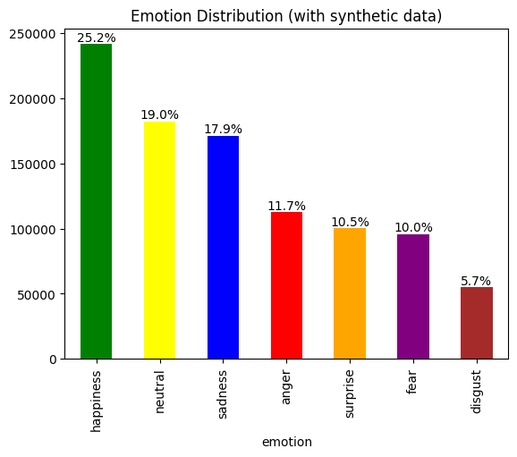
Synthetic Data Generation results
Base Emotion Distribution
Emotion Distribution with Synthetic Data

Slide 8
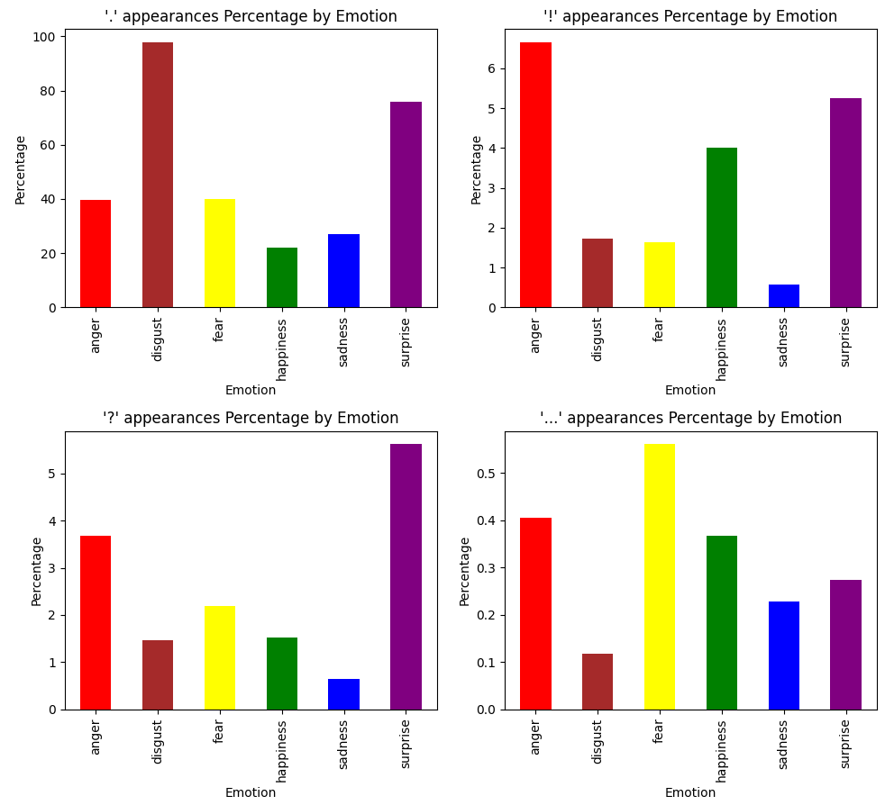
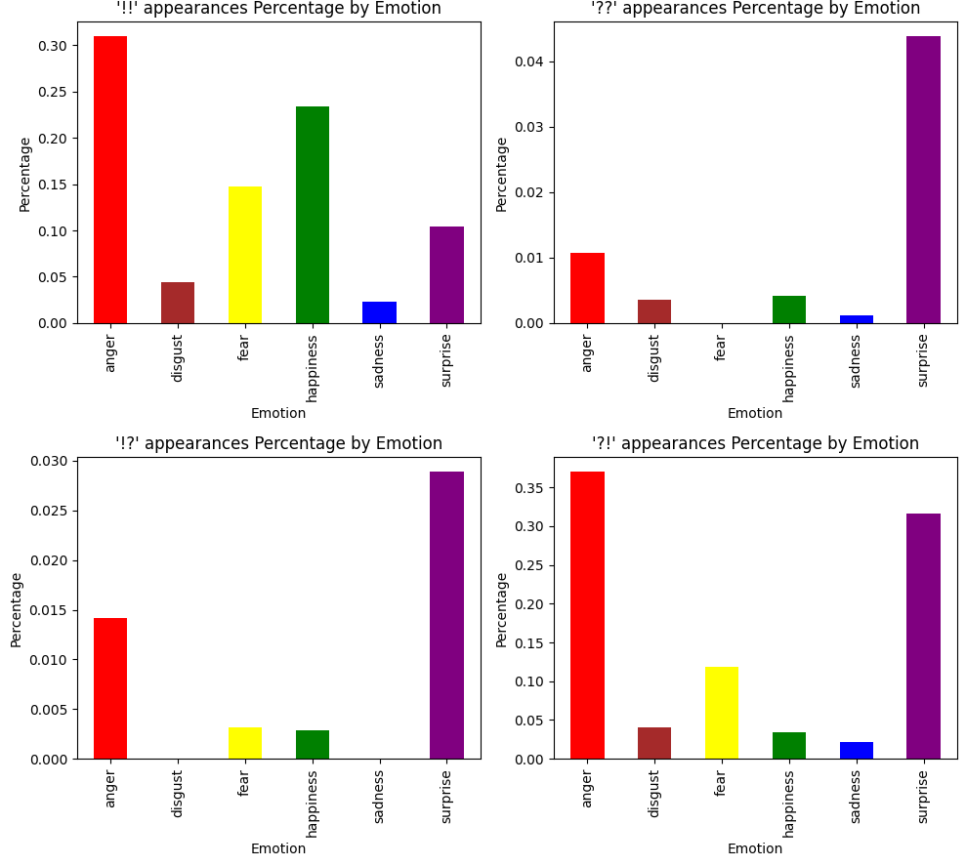
Punctuation’s role in conveying emotions
Percentage of sentences ended with “...”
Percentage of sentences ended with “!?”
Percentage of sentences ended with “?!”
“...”
“!?”
“?!”
Cleaning

Slide 9
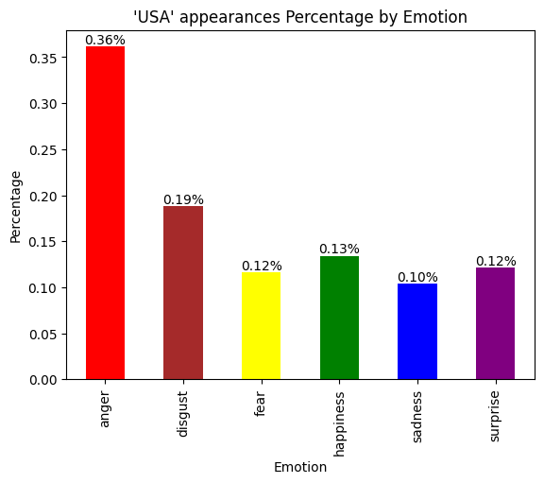
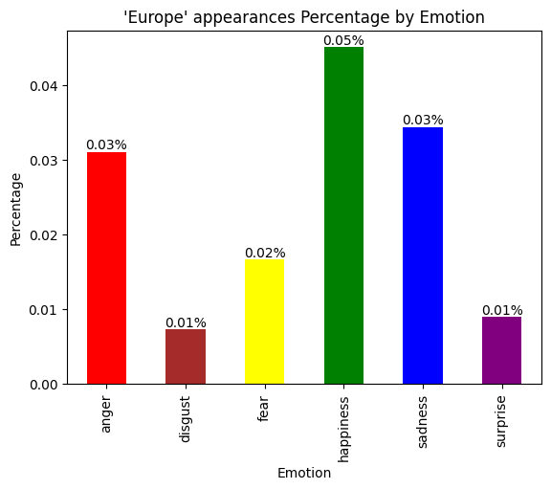
Potential bias in data - region
Percentage of sentences including “USA”
Percentage of sentences including “Europe”

Slide 10

Processing Data
Cleaning
Dropping missing values
Dropping neutral emotions
Ensure label consistency & cleanup
Dataset shuffling

Slide 11
Emotion Classification Algorithm
Models
Ensemble learning
Traditional ML(Logistic regression NB)
Neural networks(RNNs, LSTMs and GRUs )
Transformers(Bert, XLnet etc.)

Slide 12
Feature engineering
Feature engineering
Sentiment Intensity (NLTK)
Part of Speech (Word classes)
End of sentence punctuation

Slide 13
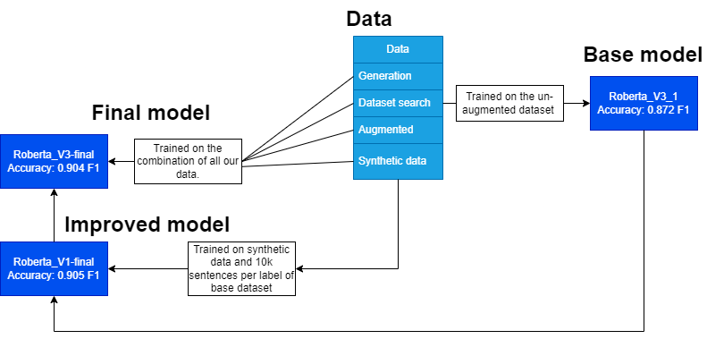
Emotion Classification Algorithm
Models

Slide 14
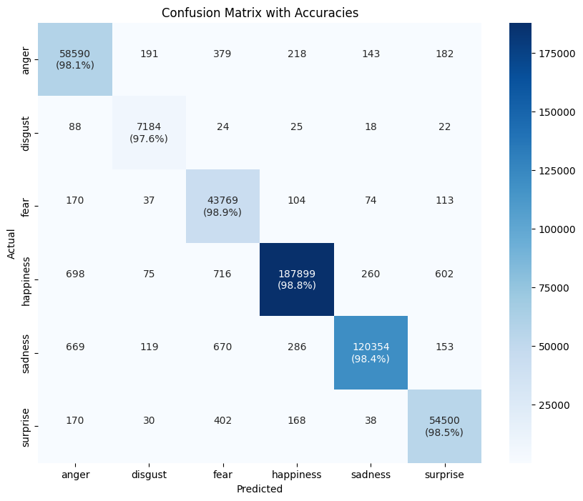
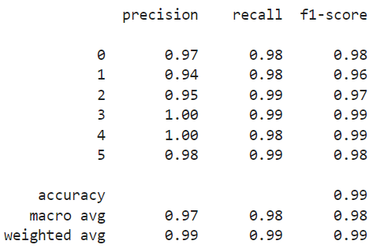
Base model
anger
disgust
fear
happiness
sadness
surprise

Slide 15
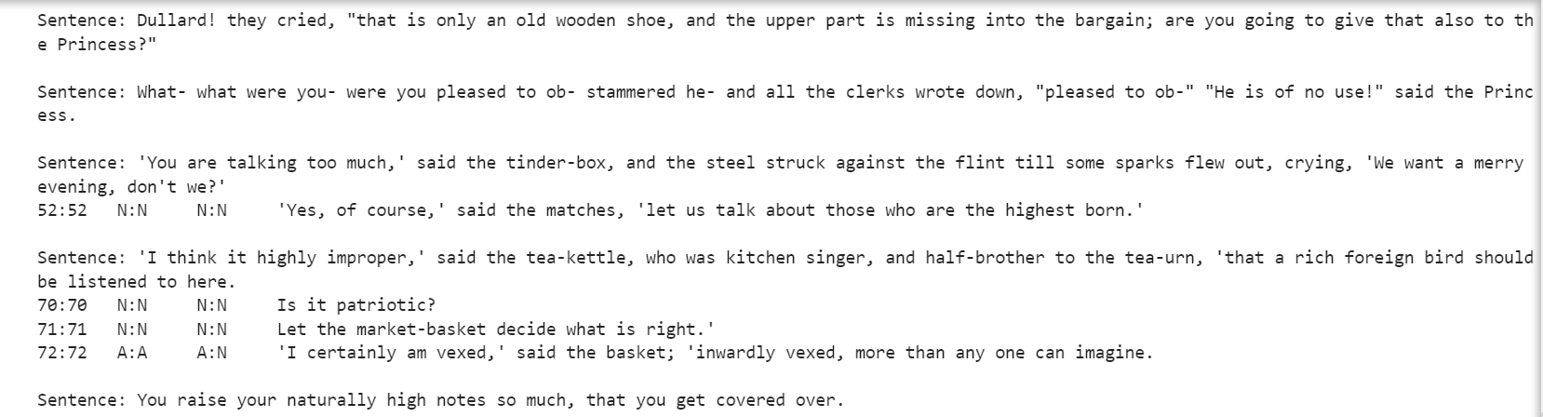
Disgust predicted as anger

Slide 16
Sentences that contain '!', are predicted as 'surprise', but are not actually 'surprise'
Number of sentences with '!' misclassified as 'surprise': 489
Sentence: There was meat in abundance, and the wolf attacked it instantly and thought, "There is plenty of time before I need leave off!" - Actual Label: happiness
Sentence: Our Lord then inquired if he had no wine, and he said, "Alack, sir, the casks are all empty!" - Actual Label: sadness
Sentence: Then said Hans to the little mannikin, "What! canst thou not pick up that piece thyself? - Actual Label: disgust

Slide 17
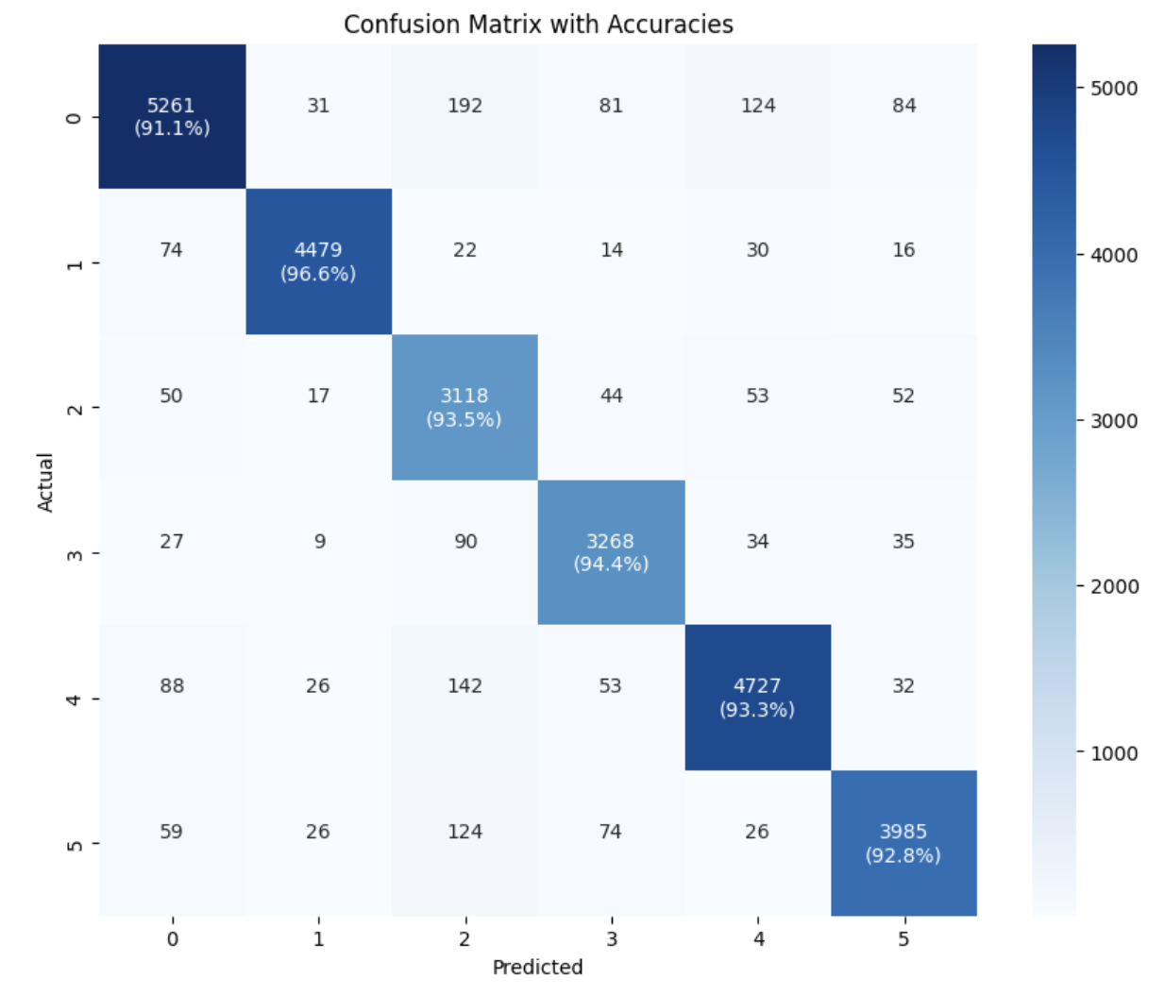
Improved model
Anger:
Precision: 94.6%
Recall: 91.1%
Disgust:
Precision: 97.6%
Recall: 96.6%
Fear:
Precision: 84.5%
Recall: 93.5%
Happiness:
Precision: 92.5%
Recall: 94.4%
Sadness:
Precision: 94.7%
Recall: 93.3%
Surprise:
Precision: 94.8%
Recall: 92.8%
anger
disgust
fear
happiness
sadness
surprise
anger
disgust
fear
sadness
surprise
happiness

Slide 18
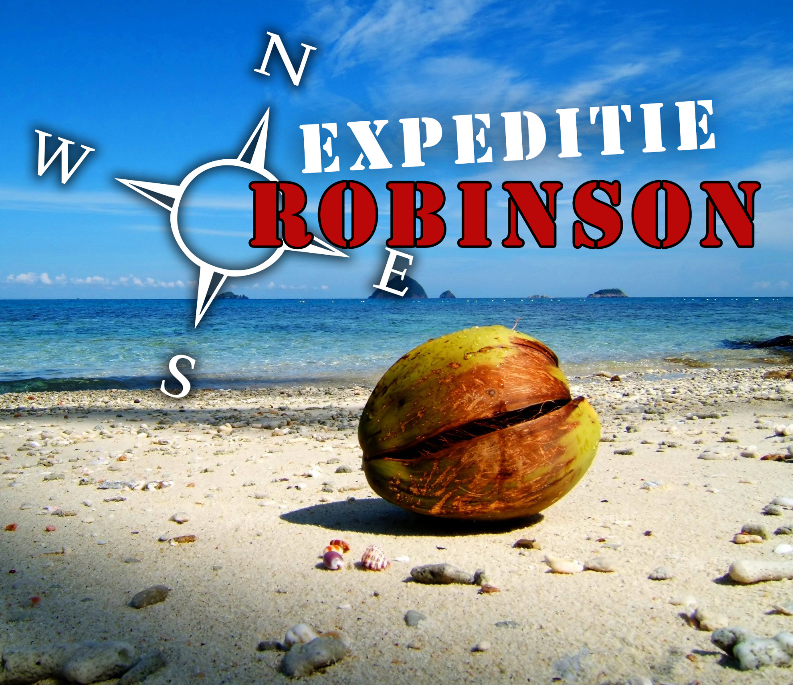
Expeditie Robinson
Data
Video data:
17 episodes in .mov format of season 22
Tabular data:
Start and End time of episode fragments
Emotion labels for fragments

Slide 19
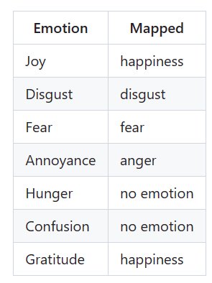
Speech-to-Text
Preprocessing the data
Converting video files to .mp3
Segment episode audio into fragments
Remapping / discarding emotion labels annotated by humans

Slide 20
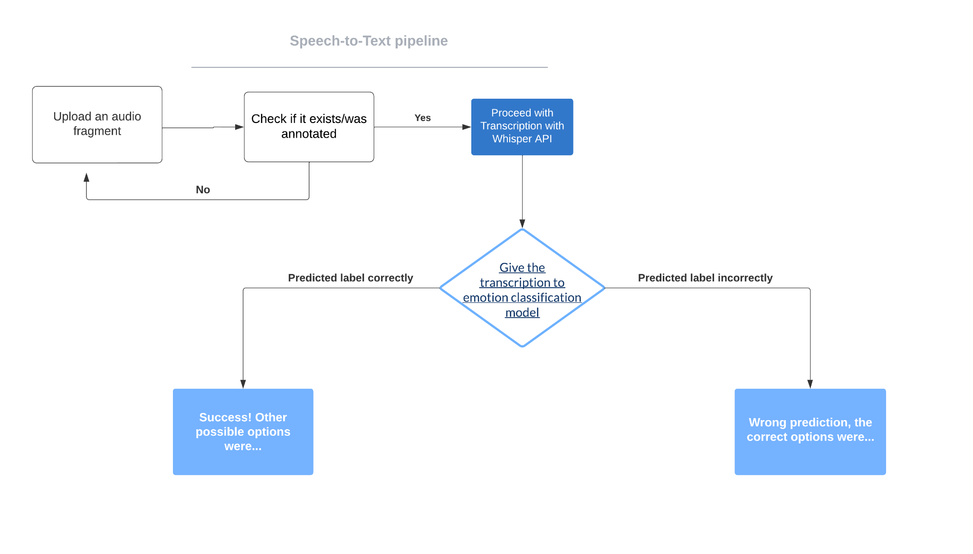
Speech-to-Text Pipeline
Pipeline explanation

Slide 21
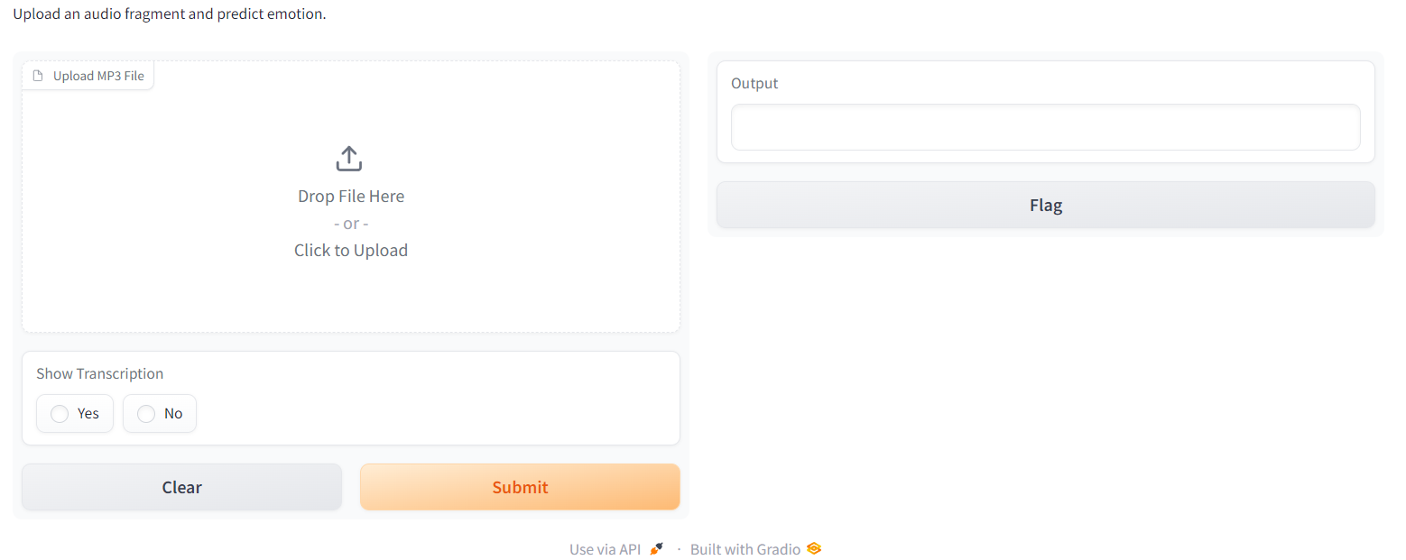
Speech-to-Text Pipeline
Pipeline explanation

Slide 22
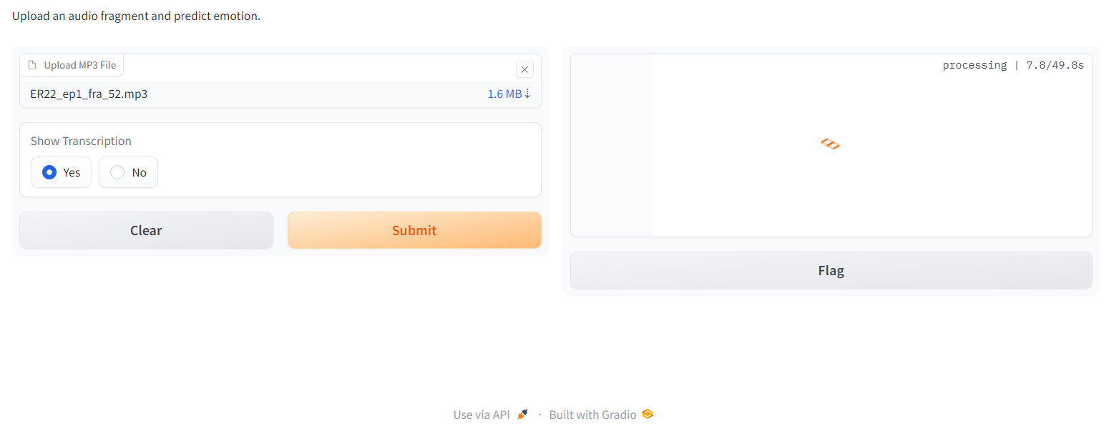
Speech-to-Text Pipeline
Pipeline explanation

Slide 23
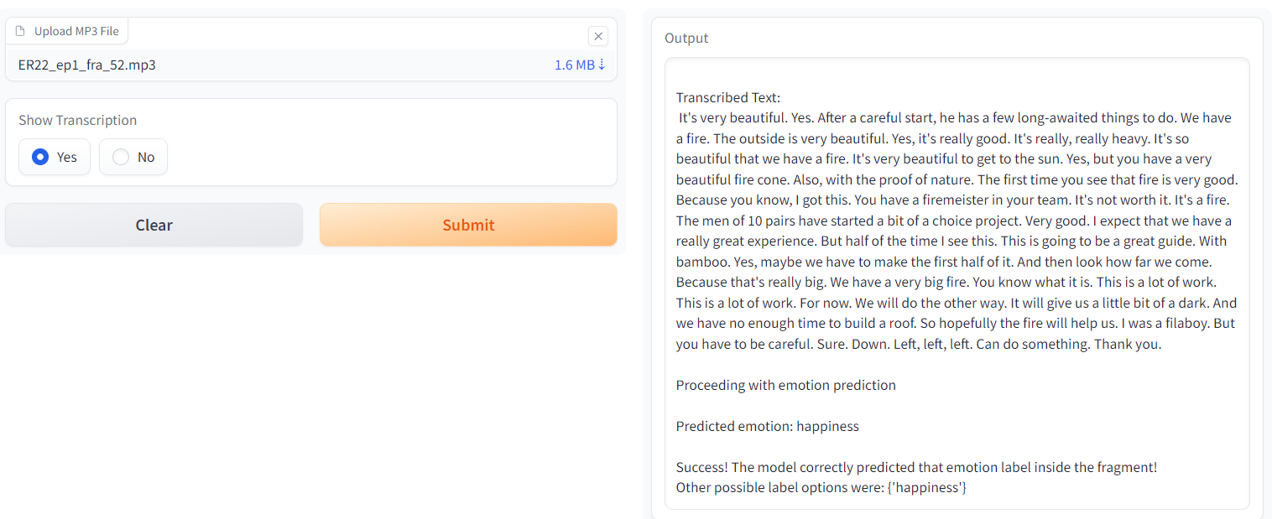
Speech-to-Text Pipeline
Pipeline explanation

Slide 24
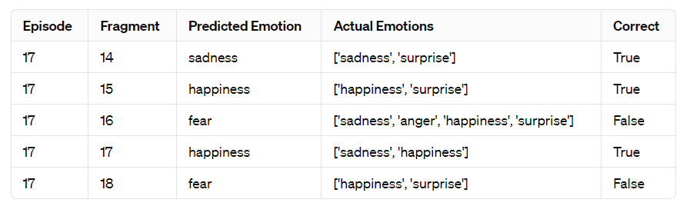
Errors on the Expedite Robinson dataset
Understanding the emotions
Accuracy of 0.38 in a total of 442 fragments

Slide 25
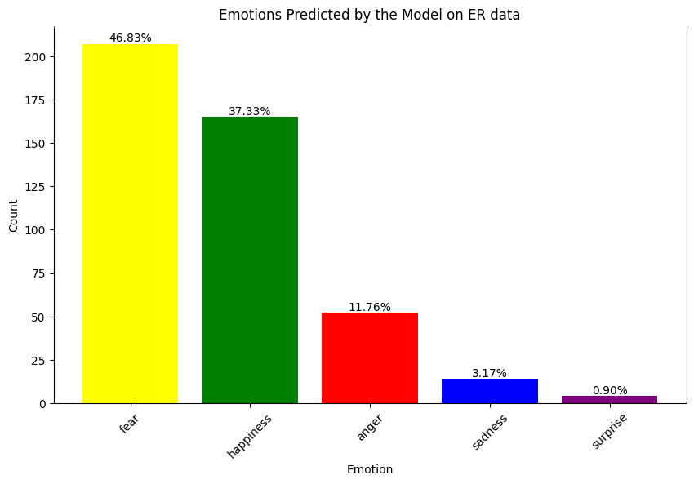
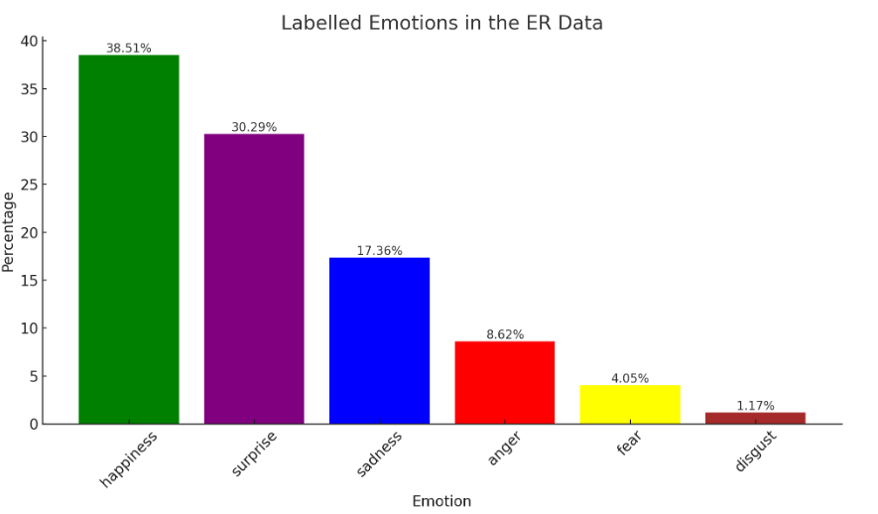
Errors on the Expedite Robinson dataset
Understanding the emotions

Slide 26
Improvement and Future Steps
Training data
Model
Speech to Text
Currently:
1 written sentence -> 1 emotion (out of 6)
Future:
3+ sentences of speech -> multiple emotions (increase the choice)
Currently
Outputs 1 emotion
Future:
Outputs multiple emotions
Currently
Whisper base model -> good accuracy + fast speed
Future:
Whisper large model ->
Excellent accuracy + slow speed

Slide 27

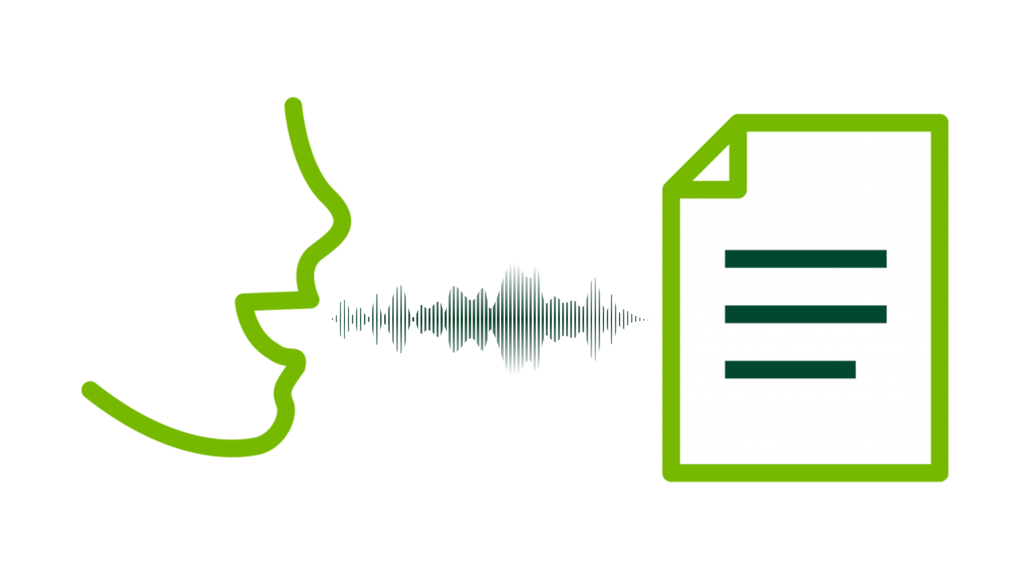
Conclusion

Slide 28
Questions?
Understanding the emotions

